Slide 1



= Safer Hires
See the risk before suffering the loss
Luke Slabaugh
602.332.5853
Lslabaugh@profitablehires.com
Mark Walker
631.617.8303
Mwalker@profitablehires.com

Slide 2
PROVEN RESULTS & BENEFITS
Reduction in claim frequency
Reduction in claim severity
Reduction in Turnover
Reduction in Auto Accidents
Failed
Background
Screen
Failed Drug
Screen
Quest Diagnostics Average 4.2%
Industry Average 10%
42%
15%
30%
12%
Our Clients Average .7%
Our Clients Average .3%
Average Return on Investment is
8 : 1

Slide 3
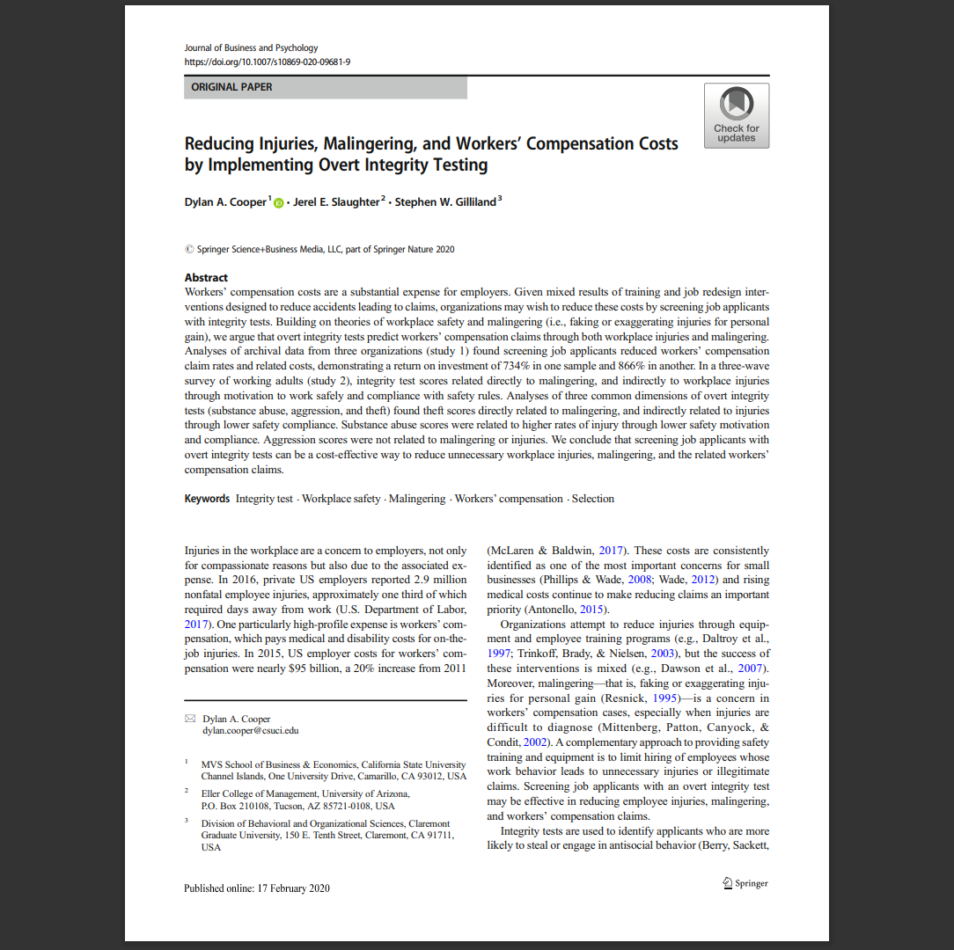
STUDY CONCLUSIONS
Published in the Journal of Business and Psychology
Overt values-based testing reduced both WC claim rates and costs
Effects stronger for costs than claim rates
Suggests tests may reduce both unsafe behavior and faking or exaggerating claims (malingering)
This scientific study proves this overt style of testing leads to fewer claims and costs because :
Passing employees are safer and are less likely to be injured
Passing employees are less likely to fake or exaggerate injuries
DOUBLE BLIND AND PEER-REVIEWED BEFORE PUBLISHING

Slide 4
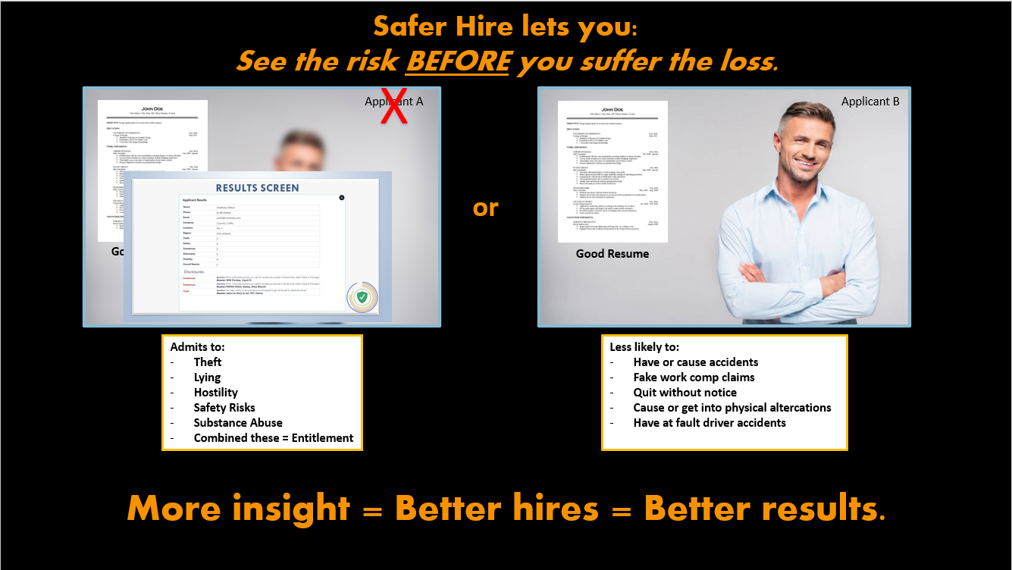
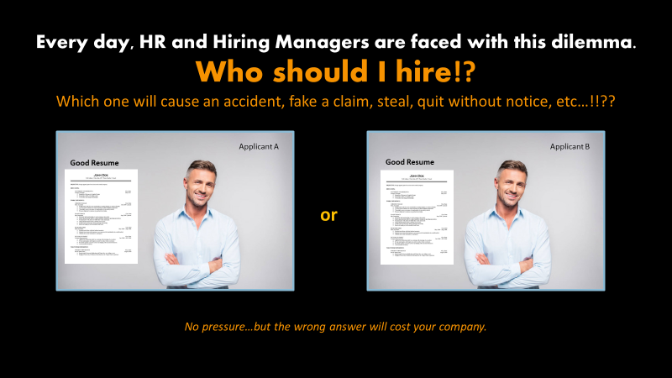
WHAT IS SAFER HIRE?
HOW DOES SAFER HIRE WORK?
Safer Hire is a simple 9 min. pre-hire screen and is a highly reliable, cost-effective Pre-Claim Risk Management Tool. Used to identify candidates who are high risk for claims. Organizations are then able to avoid making costly hires impacting; Workers Comp, Turnover, Employee Conflict Issues, Lost Productivity, and more.
By identifying candidates with an entitlement attitude and skewed values, employers avoid hiring those candidates who are high risk for claims and safety incidents.
On average, clients using testing such as Safer Hire see a reduction in:
- WC claim frequency by 42%
- WC claim severity by 15%
- Employee turnover by 30% Average Return on Investment is 8:1!
NOW THE CHOICE IS CLEAR
- Admission in 1st 3 screens
- Referred us to friend within 7 days of screening
- “Based on the answers we can now see; I know we have insight into applicants we never had before.” – client comment within 1st 30 days
Avoid that 10 – 20% that cause 90% of your problems.

Slide 5
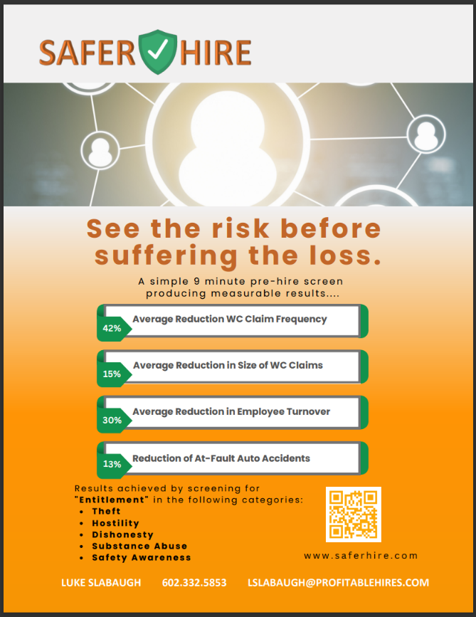
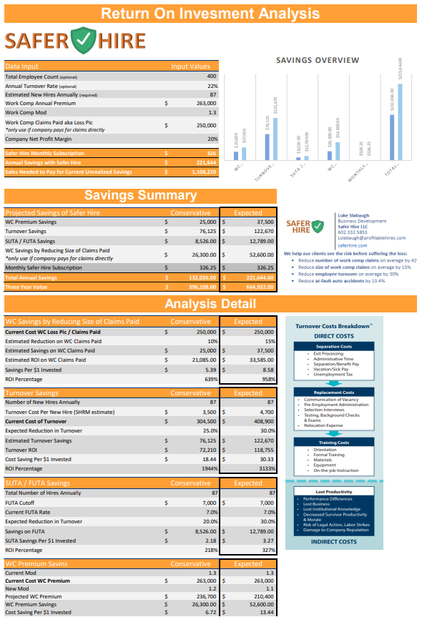
WHAT DO I DO AS A PARTNER?
You Don’t have to be the expert. Simply make the introduction and Schedule a conversation.
Insert and share the following 2 brochures on every presentation.
Response for any question: “That’s a great question. Let’s make that the first thing we ask on our call.”
To Customize ROI
Email me 4 items:
1. Estimated New Hires Annually
2. Work Comp Annual Premium
3. Work Comp Mod
4. Work Comp Claims Paid
(applies if in captive, self insured, or
high deductible plans)
It’s easy to schedule your client demo in real time using this link in my email signature.
Luke Slabaugh
P: 602.332.5853
https://calendly.com/luke-calendar
Mark Walker
P: 631.617.8303
https://calendly.com/mark_calendar

Slide 6

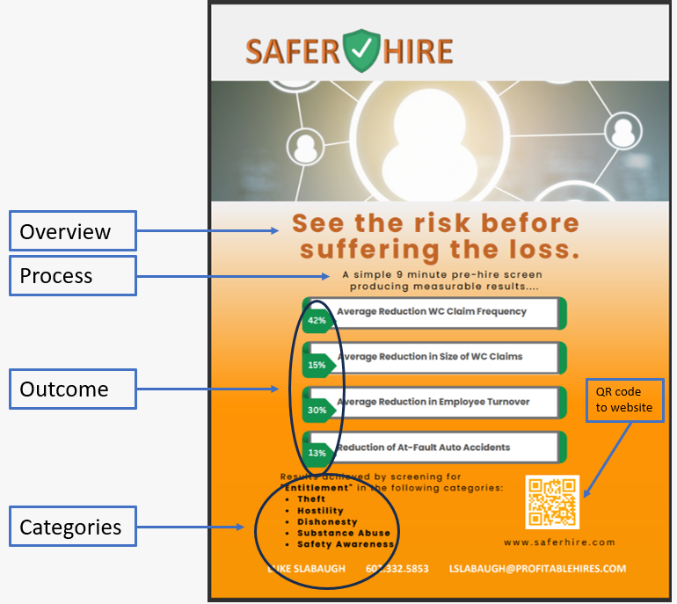
Example – Partner Email to Clients
Good afternoon. I'm reaching out to let you know of an exciting resource we offer our clients. Safer Hire is a simple 9 min. pre-hire screen and is a highly reliable, cost-effective, PRE-CLAIM risk management tool.
Safer Hire lets you see the risk BEFORE suffering the loss.
On average clients using Safer Hire see the following results:
- 42% reduction in Work Comp Claim Frequency
- 15% reduction in Work Comp Claim Size
- 30% reduction in Turnover
- 13.4% reduction in at fault auto accidents
- AND...The average return on investment is 8:1!
Please reach out to me to schedule a brief conversation so that, at a minimum, you are aware of this valuable solution we recommend.

Slide 7
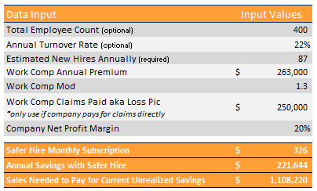
ROI Analysis
Only 4 items to customize ROI Email me:
1. Estimated New Hires Annually
2. Work Comp Annual Premium
3. Work Comp Mod
4. Work Comp Claims Paid (if applicable)
Low Risk High Reward
- no sign-up fees
- no long term contracts

Slide 8
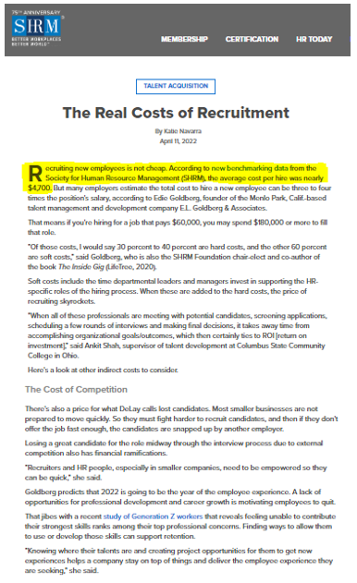
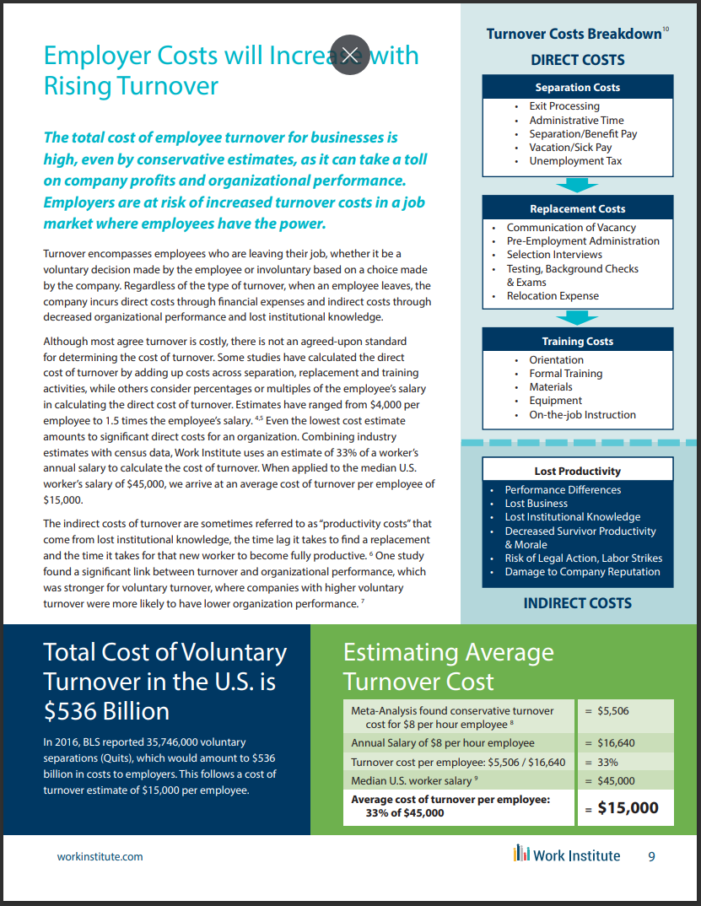
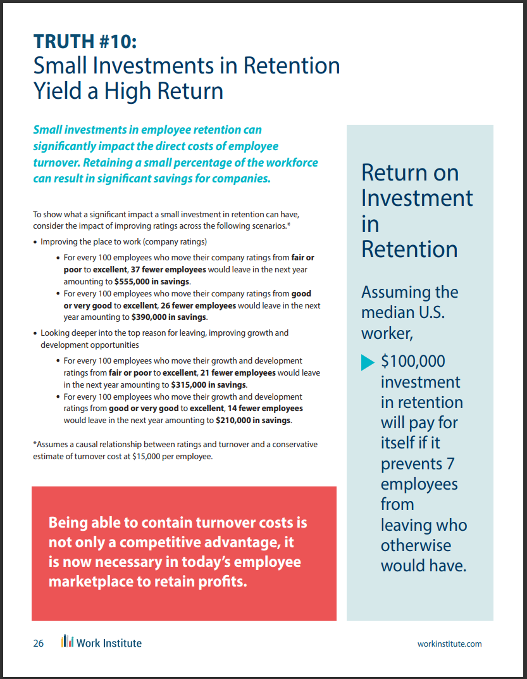
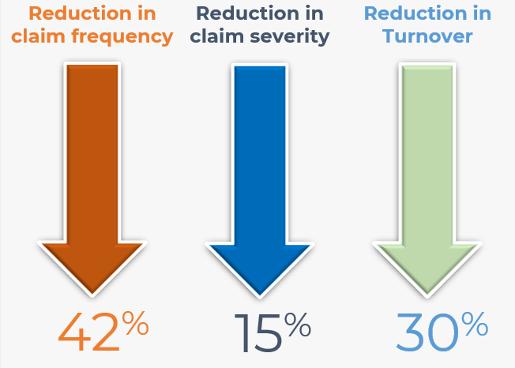
The work comp turnover connection:
Direct Costs
&
Indirect Costs
Avoiding bad hires pays BIG returns.
$4,700 per hire
  33% of all work comp claims happen within the first 12 months of hire
  65% of all workplace accidents are a result of drugs and alcohol
  AND an entitlement mentality refuses help/training
  FUTA paid on 1st $7k of payroll, New employees are still learning therefore less productive, and the list goes on…

Slide 9
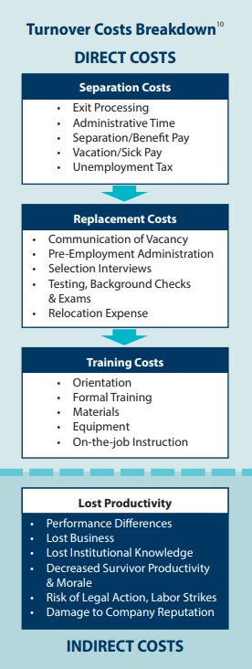
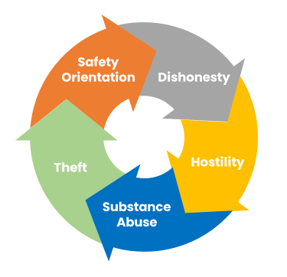
THE COSTLY PROCESS OF TURNOVER
Hiring Consistency
Consistent Process Placement
Consistent Candidate Questions
Consistent Results on Responses
Operational
Efficiency
Focus on Top Candidates
Increase Speed to Hire
Improve Candidate Experience
Quality
of Hire
Decrease Turnover (especially Involuntary)
Reduce WC Claims (Frequency & Severity)
Improve Company Culture
Higher Customer Satisfaction
Legal Compliance
Avoid that 10 – 20% that cause 90% of your problems.
Validated
Non-Discriminatory

Slide 10
Elements of Safer Hire
1.) Psychology
– 5 categories identify an entitlement mentality
2.) Process
– simple and easy
3.) Pricing
– it will cost more not to use Safer Hire
millions
of applicants
tested

Slide 11

WHY IS Safer Hire UNIQUE
Covert
(Personality)
Overt
VS
(Self Admitting)
Ambiguous Questions
Ambiguous Results
Straight Forward Questions
Clear Measurable Results
- The EEOC endorses this type of testing because it is overt and self admitting
- Immediate impact is easy to see with applicant responses

Slide 12
5 FACTORS = ENTITLEMENT
“I’m better than everyone else, the rules don’t apply to me, and I’m owed something just because I showed up today.”
Counter-Productive Behaviors
Skewed Value Systems
Entitlement Attitude
Entitled individuals are resistant to training and likely to abuse systems in your organization because they feel it is owed to them or they “deserve” something for nothing.

Slide 13

BEHAVIORAL PSYCHOLOGY
“Why would anyone tell you these things while they are applying for a job!?”
Cognitive Dissonance
Rationalize/justify ‘risky’ behavior as normal
I only steal sometimes
Everyone hits when angry
Everyone uses some illegal drugs
I’ve been honest with you now make an exception for me (entitlement)

Slide 14
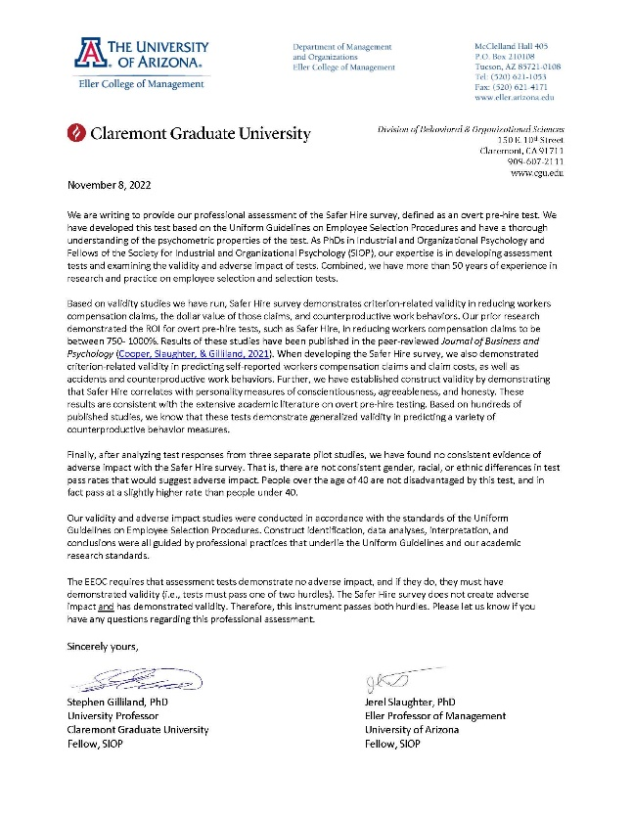

COMPLIANT & VALIDATED
EEOC requires that a test must be either
non-discriminatory or validated to be compliant
OR
Non-discriminatory
Validated

Slide 15
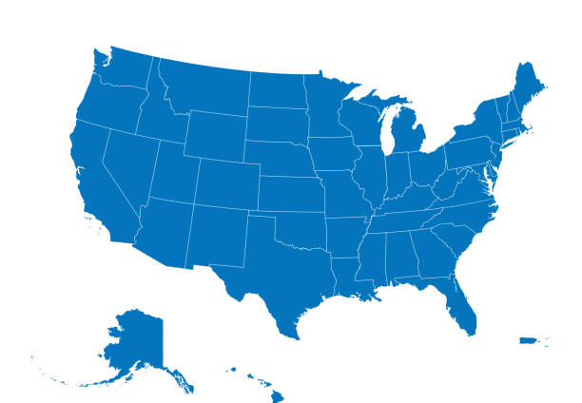

INDUSTRIES & STATES
Construction
Food Processing
Healthcare
Hospitality
Manufacturing
Retail
Staffing
Compliant in all states & industries

Slide 16



FAST FACTS
WHAT TO LOOK FOR?
<9 min., 56 questions
5th grade reading level
English, Spanish, + 90 optional languages
Online, Pass/Fail results
Mobile Optimized
Completion Rate > 99%
Integration Capability
80% Passing Rate
  1 or 2 out of 10 will tell you, “If you hire me, I will do these things.”
Avoid that 10 – 20% that cause 90% of your problems.

Slide 17
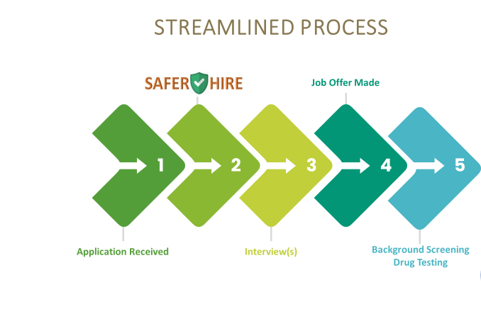

Slide 18
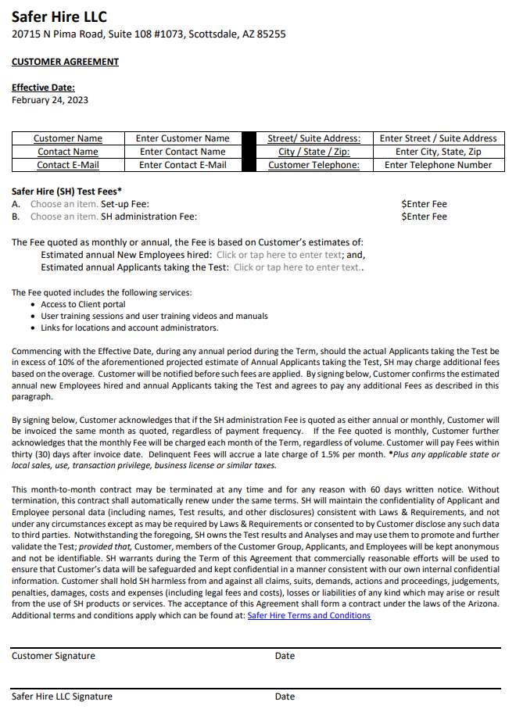
Low Risk High Reward:
- Simple one page agreement
- Sent via DocuSign
- No setup fees
- No long term contracts
Includes:
- Setup and training
- Screening and Results
- Benchmark Studies
- Validation Studies
- Adverse Impact Studies
- Business Impact Studies
Measurable Results!

Slide 19

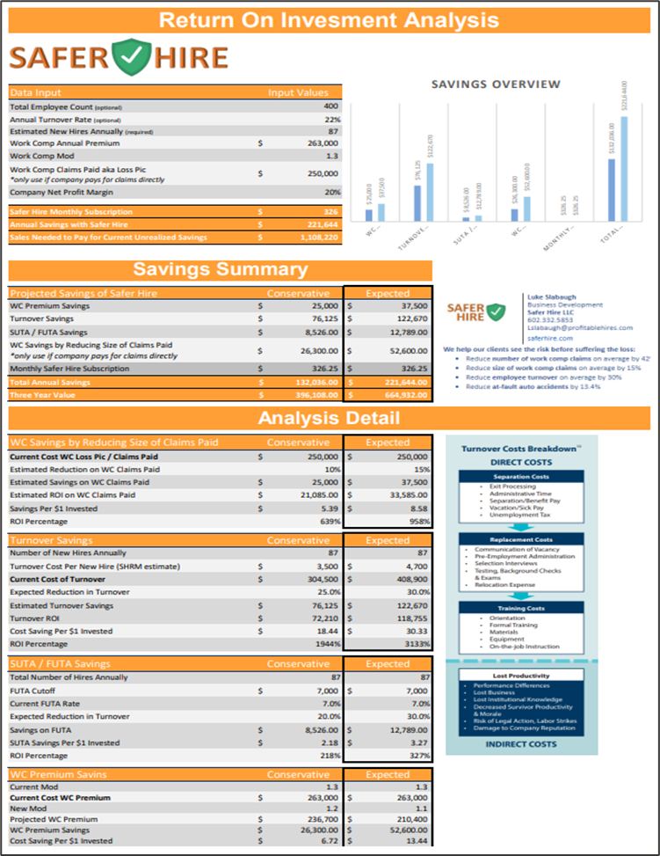
THE 2 PRICING CONVERSATIONS:
What will it cost? vs. What is it costing us today?
Subscription Options:
  1. Monthly Per Screen
    Only pay for what you use
  2. Monthly Estimated Hires
    Good for financial forecasting
    Good for high applicant to hire ratio
  3. Annual Estimated Hires
    Get a 10% discount for paying annually
1.
1. Investment in Safer Hire
Hidden Costs of Not Working with Safer Hire:
2. HIDDEN COSTS of not working with Safer Hire aka (Current Expense)
Save Money, Time, Hassle:
• Save $ - Workers Compensation Loss Rates
• Save $ - Turnover
• Save $ - SUTA/FUTA
• Save $ - OSHA
• Save $ - Litigated Work Comp Claims
• Save $ - Frictional Costs
• Save $ - Loss of Production
• Save $ - Employee Theft
• Save $ - FMLA, STD, LTD & Sick Leave
2.

Slide 20




WORKING TOGETHER AS A TEAM
You meet with clients as you always have BUT you let them know you have a unique solution
Use our contact info below to schedule a presentation
Safer Hire Team takes care of presentation, implementation & training / on-going maintenance etc.
You look like the hero, by helping your clients.
Life is good!
You Don’t have to be the expert. Make the introduction. Schedule a conversation.
Luke Slabaugh
P: 602.332.5853 LSLABAUGH@PROFITABLEHIRES.COM
https://calendly.com/luke-calendar
Mark Walker
P: 631.617.8303
MWALKER@PROFITABLEHIRES.COM
https://calendly.com/mark_calendar

Slide 21

Additional Ways We Can Support You:
Start with high claims/costly clients
    see greatest impact soonest
20 min. educational webinars for your team, and then clients and prospects
Include Safer Hire in your list of risk-reduction resources on websites and portals
Schedule educational sessions with your client facing risk advisors
  This prepares your team to make the simple introduction vs trying to sell Safer Hire themselves
The above are simply suggestions. You know your process and we are here to make you look good so please let me know how we can best serve you.

Slide 22
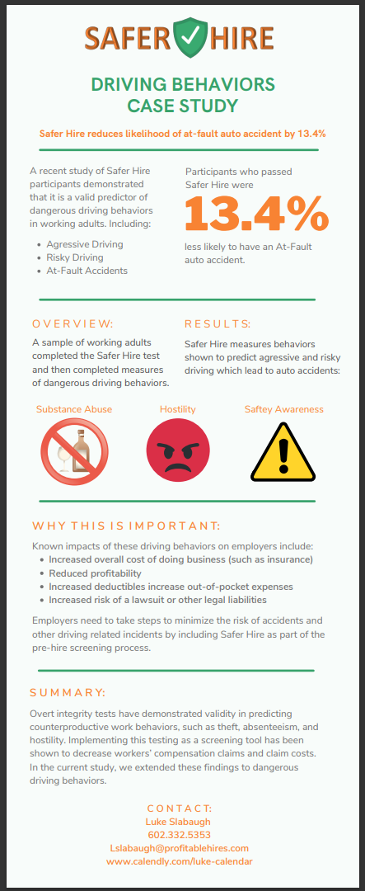
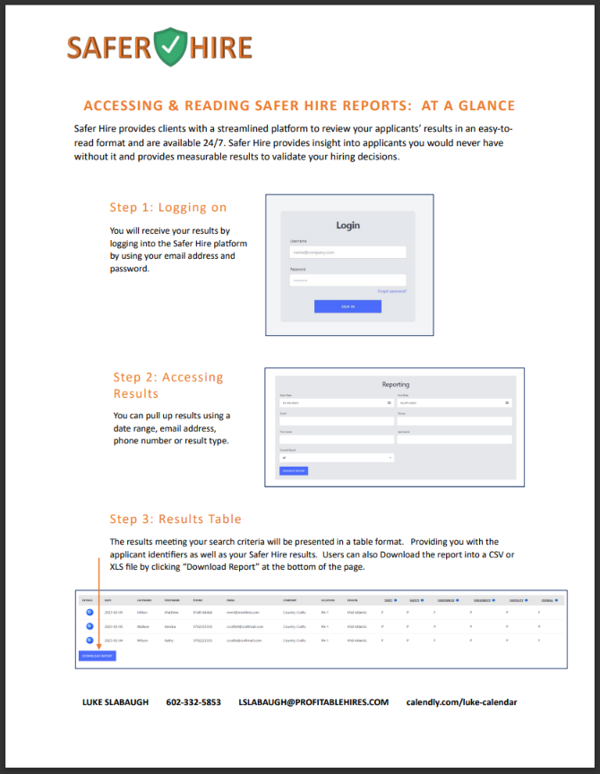
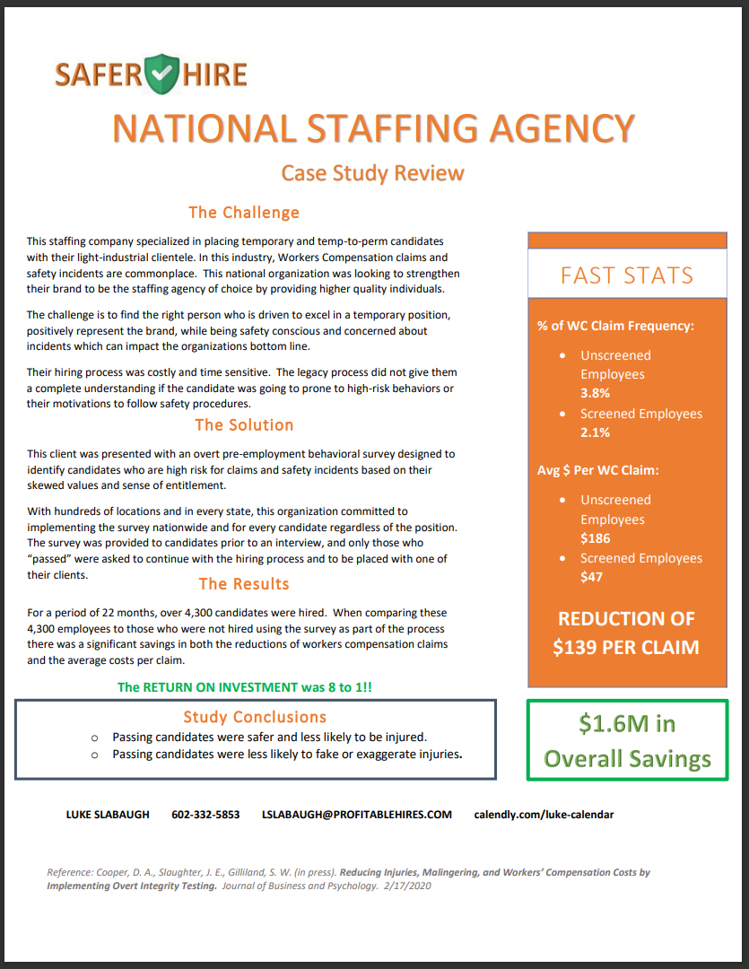
Additional Resources Available Upon Request
Case Studies
Overviews
Platform Demos
And more…

Slide 23
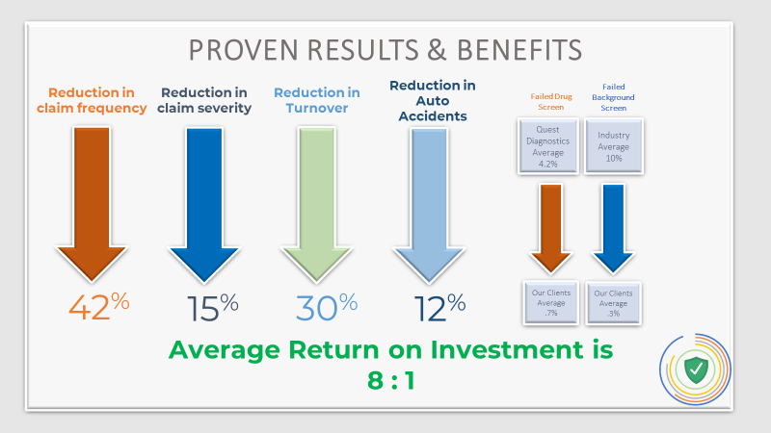
Safer Hire on One Page
Fast Facts
<9 min., 56 questions
5th grade reading level
Eng., Span., + 90 optional languages
Immediate Online Pass/Fail results
Mobile Optimized
EEOC Compliant
Abandonment Rate: < 99%
Integration Capability
80% Passing Rate
What is Safer Hire:
Safer Hire is a 9 min. pre-hire screen and is a highly-reliable, cost-effective Pre-Claim Risk Management Tool. Used to identify candidates who are high risk for claims. Organizations are then able to avoid making costly hires impacting; Workers Comp, Turnover, Employee Conflict Issues, Lost Productivity, and more.
How Does Safer Hire Work:
By identifying candidates with an entitlement attitude and skewed values, employers can avoid hiring those candidates who are high risk for claims and safety incidents. On average, clients using testing such as Safer Hire see a reduction in WC claim frequency by 42%, WC claim severity by 15% and employee turnover by 30%. Average Return on Investment is 8:1!
Problems Safer Hire Solves for:
High Turnover
High Workers Comp Claims (Frequency & Severity)
High Safety Incidents
Poor Employee Behavior
Low Productivity
What Industries Are Best Suited for Safer Hire:
Safer Hire is not industry or position specific. It can be used by anyone experiencing the “problems” identified above. Below are industries where the greatest successes have been realized:
Hospitality/Food & Beverage
Construction
Manufacturing
Senior Living / Healthcare
Retail
Agriculture
Luke Slabaugh 602.332.5853 LSLABAUGH@PROFITABLEHIRES.COM
5 Factors = Entitlement
Counter-Productive Behaviors
Skewed Value Systems
Entitlement Attitude

Slide 24
PARTNER SUCCESS STORIES
Remember – “This is one of our unique solutions, lets schedule a 30 min. conversation with Luke so you are aware of what it could mean for you.”
We help our partners retain accounts and win new business simply by adding Safer Hire to your proposals. Bring us in to your conversations early, before it's too late! (see examples)
Partner 1: Our partner had a tough renewal with a longtime six figure client that had already signed a BOR to a new agency. By showing the ROI with Safer Hire, which was greater than the amount of their work comp premium, our partner was able to have the BOR rescinded and retain this client for another year!
Partner 2: The client was looking for new tools to address questionable claims as well as reduce real work comp claims. We presented Safer Hire during the annual review for this account and the client committed to implementing Safer Hire on the spot...and then referred a friend of theirs within 1 week of use!
Partner 3: This partner called us while completing an RFP because they needed a unique angle to stand out from their competitors. We were able to show a major improvement in time savings during the hiring process as well as a huge overall financial advantage when compared to competitors in the RFP process.
Send me a quick email or give me a call with the details your client is looking to accomplish. I am happy to send you ROI's, marketing materials as well as jump on the phone for a quick presentation.
We are here to serve you and make you look good!
Let us know how we can help!

Slide 25
WHAT DO I DO AS A PARTNER?
You Don’t have to be the expert. Simply make the introduction and Schedule a conversation.
Insert and share the following 2 brochures on every presentation.
Response for any question: “That’s a great question. Let’s make that the first thing we ask on our call.”
To Customize ROI
Email me 4 items:
1. Estimated New Hires Annually
2. Work Comp Annual Premium
3. Work Comp Mod
4. Work Comp Claims Paid
(applies if in captive, self insured, or
high deductible plans)
It’s easy to schedule your client demo in real time using this link in my email signature.
Luke Slabaugh
P: 602.332.5853
https://calendly.com/luke-calendar
Mark Walker
P: 631.617.8303
https://calendly.com/mark_calendar

Slide 26
= Safer Hires
QUESTIONS & ANSWERS
Luke Slabaugh
602.332.5853
Lslabaugh@profitablehires.com
Mark Walker
631.617.8303
mwalker@profitablehires.com

